Slide 1
Sets and Relations

Slide 2
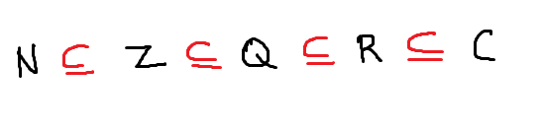
Standard Symbols to denote numbers are
N : The set of all natural numbers (i.e.,all positive integers)
Z : The set of all integers
Q : The set of all rational numbers
R : The set of all real numbers
C : The set of all complex numbers

Slide 3
Natural numbers are 1, 2, 3, 4, 5, ….
Whole numbers are 0, 1, 2, 3, ….
Integers are …, -2, -1, 0, 1, 2, …
Rational numbers are written in the form a / b
where a and b are integers, and b != 0
6/2 is a rational number.
We don’t write rational numbers with decimal point
All decimals which terminate or repeat are rational numbers
Irrational numbers do not terminate nor repeat
pi is an example
Real numbers composed of rational and irrational

Slide 4
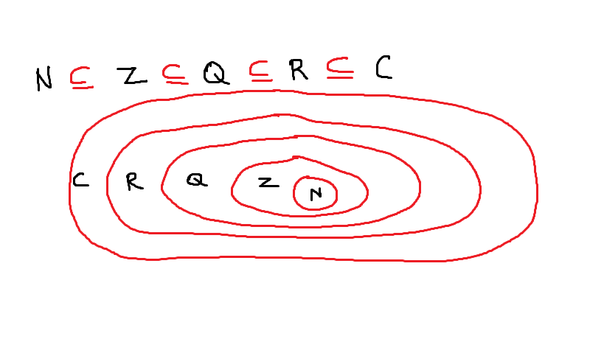

Slide 5
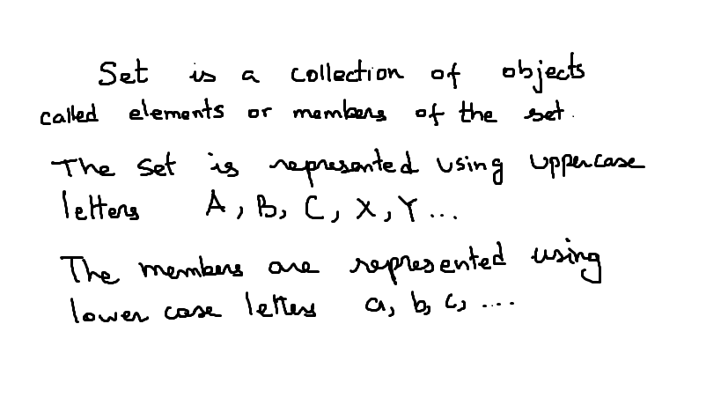

Slide 6
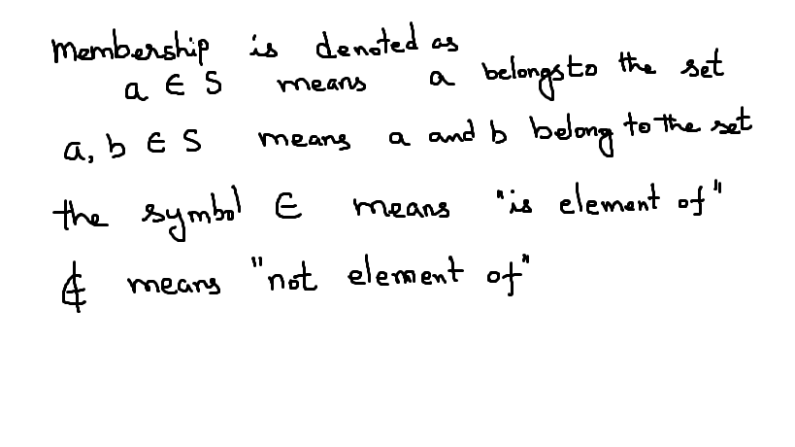

Slide 7
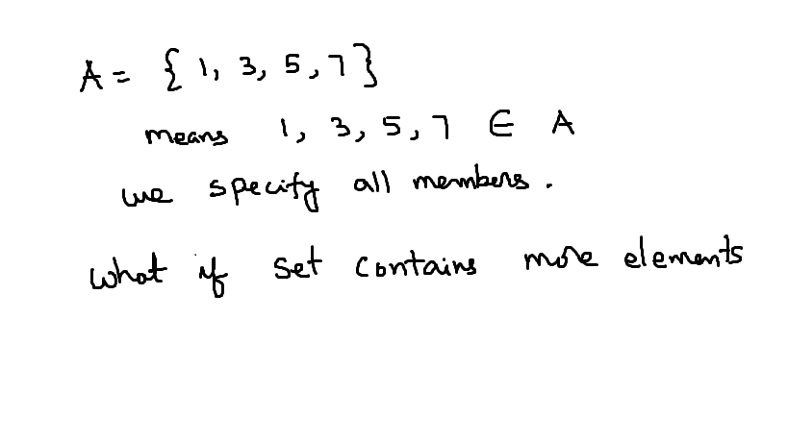

Slide 8
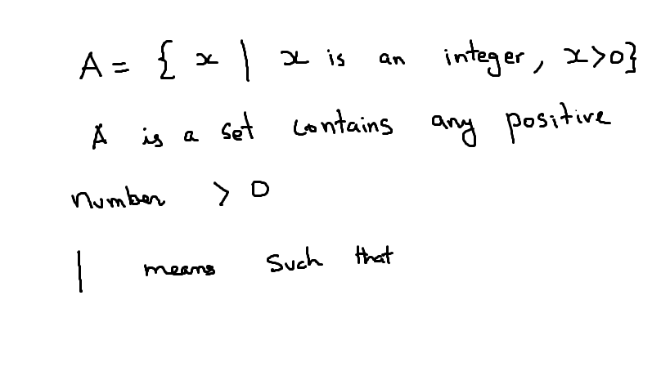

Slide 9
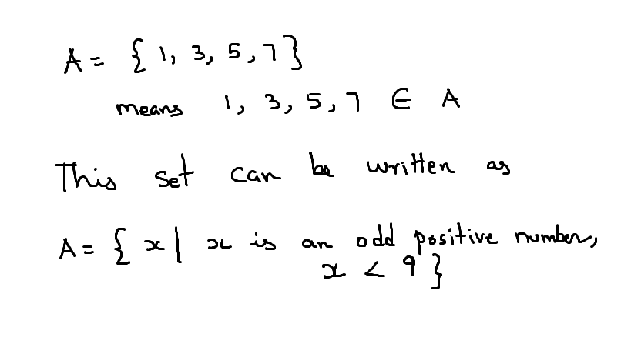

Slide 10
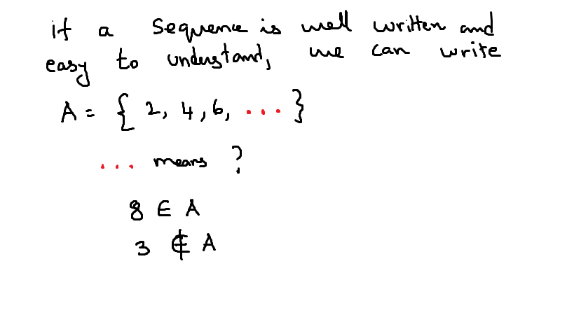

Slide 11
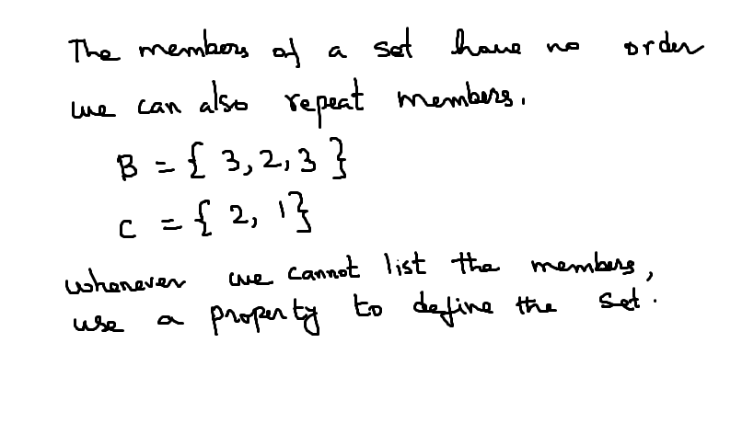

Slide 12
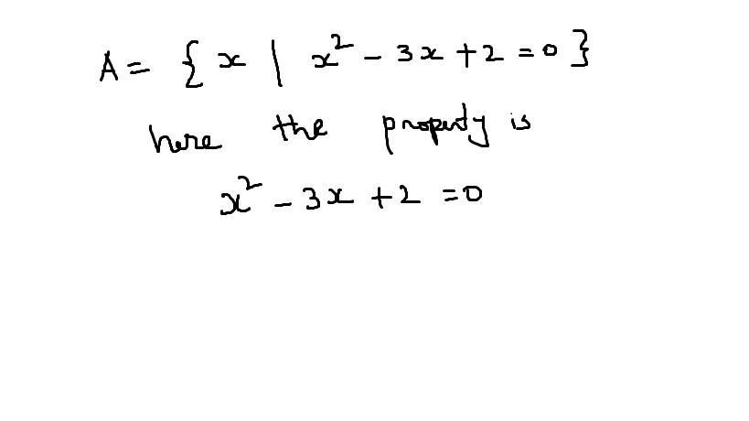

Slide 13
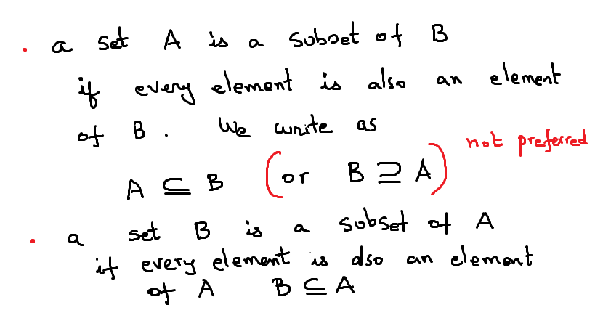

Slide 14
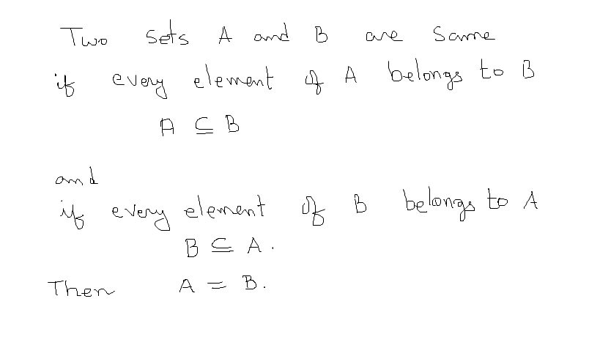

Slide 15
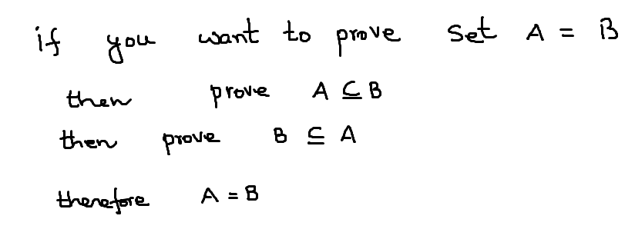

Slide 16
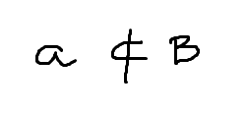
if one or more elements of A do not belong to B, then we write

Slide 17
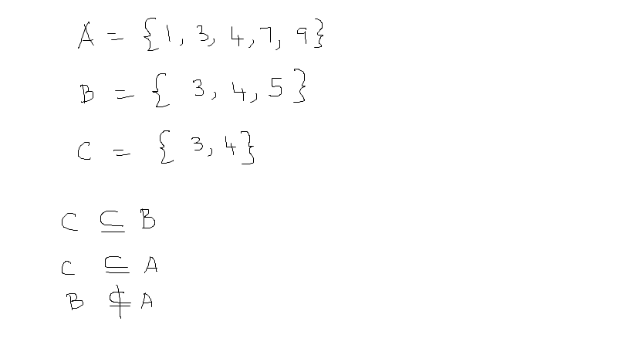

Slide 18
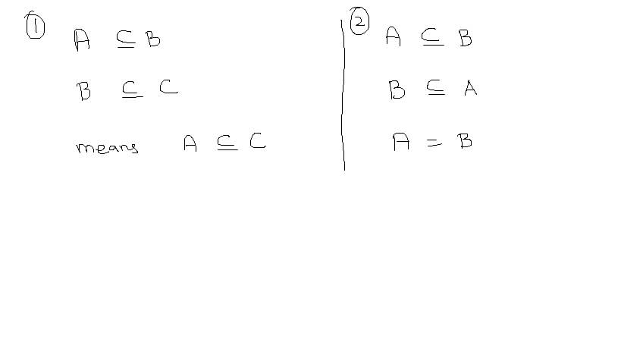

Slide 19
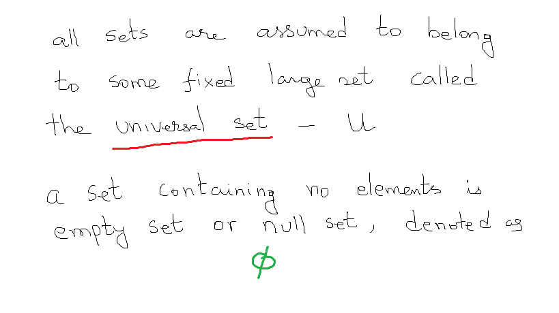

Slide 20
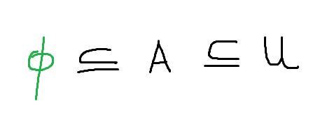
If two sets A and B are empty, then they are same sets.
An empty set is regarded as a subset of every set.
Thus for any set A, we have
Empty set is a subset of A
A is a subset of U

Slide 21
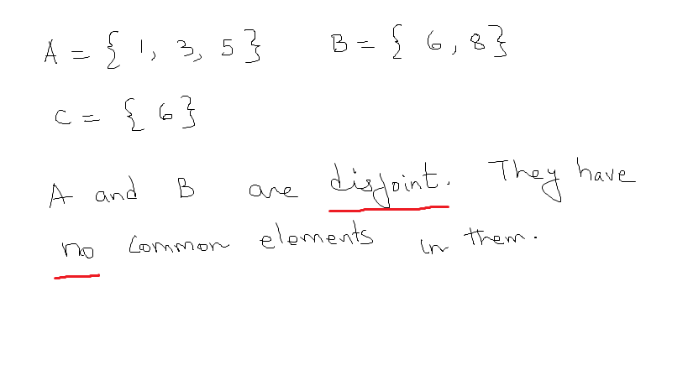

Slide 22
Proper Subset
X and Y are sets. X is a proper subset of Y if X ⊆ Y and there exists at least one element in Y that is not in X. This is written X ⊂ Y.
Example:
X = {a,e,i,o,u}, Y = {a,e,i,o,u,y}
X ⊂ Y , since y ∈ Y, but y ∉ X

Slide 23
Set Equality
X and Y are sets. They are said to be equal if every element of X is an element of Y and every element of Y is an element of X, i.e. X ⊆ Y and Y ⊆ X
Examples:
{1,2,3} = {2,3,1}
X = {red, blue, yellow} and Y = {c | c is a primary color} Therefore, X=Y

Slide 24
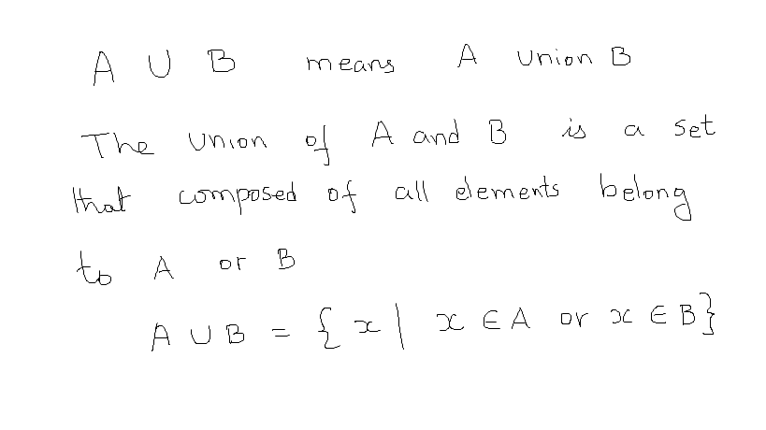
Operations on Sets: Union

Slide 25
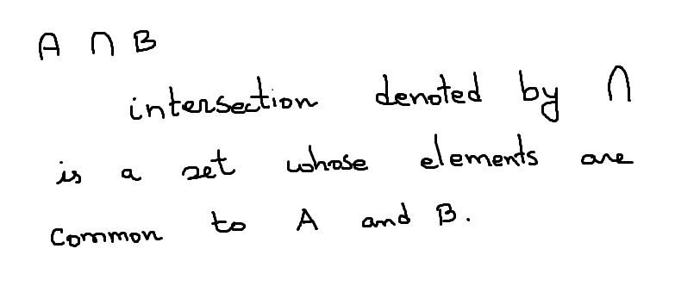
intersection

Slide 26
Venn Diagrams
we also use venn diagrams to visual represent sets and operations

Slide 27
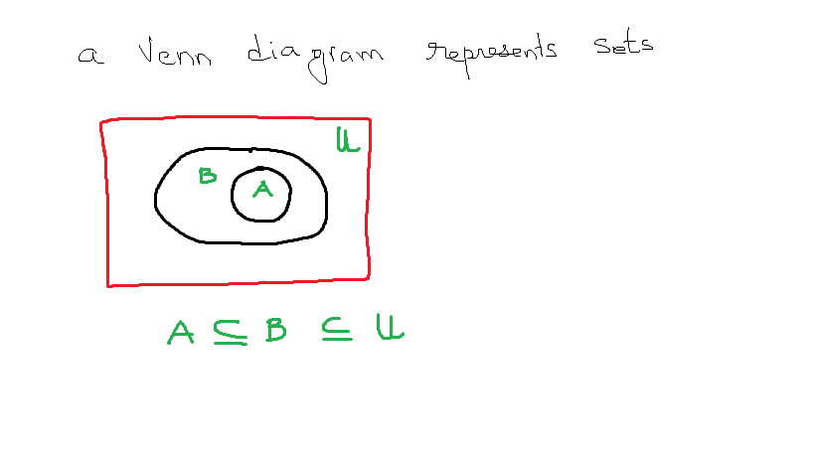

Slide 28
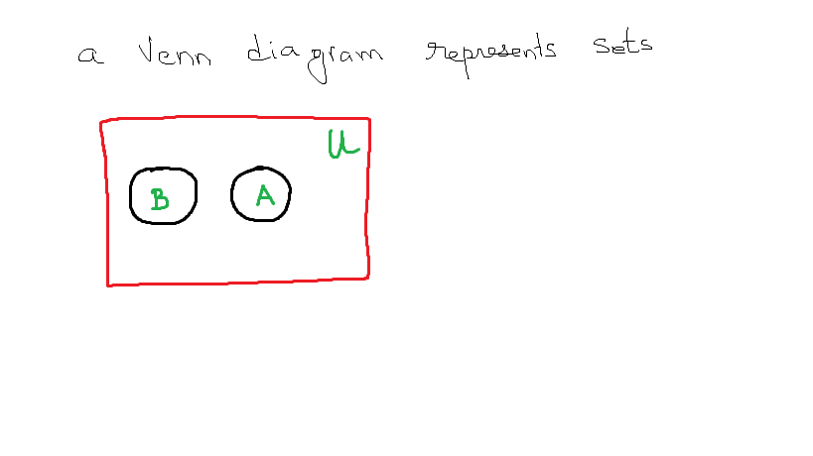

Slide 29
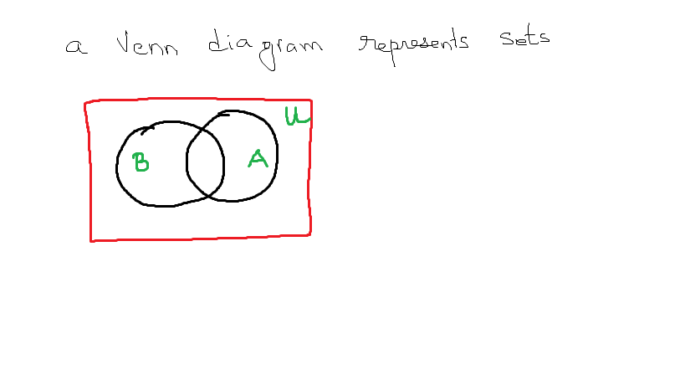

Slide 30
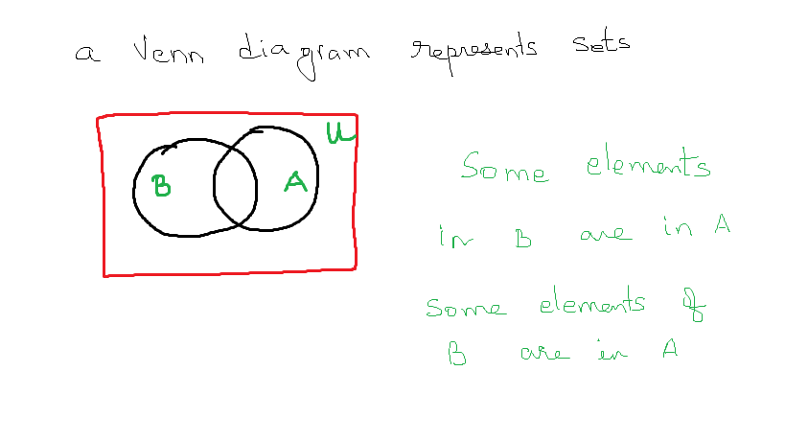

Slide 31
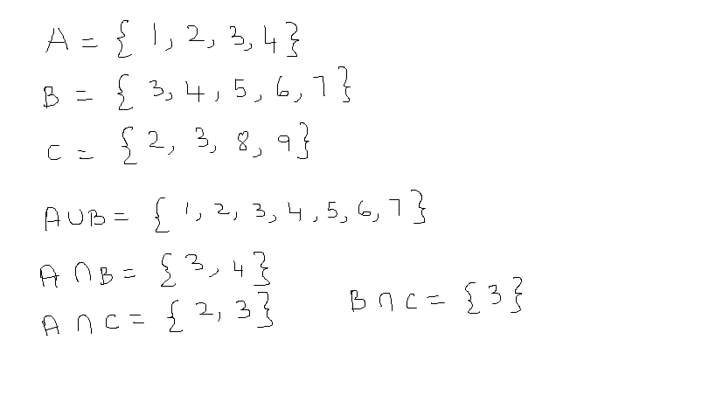
example

Slide 32
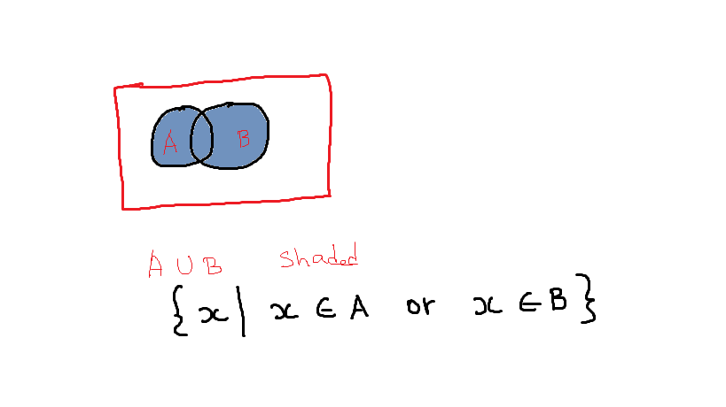

Slide 33
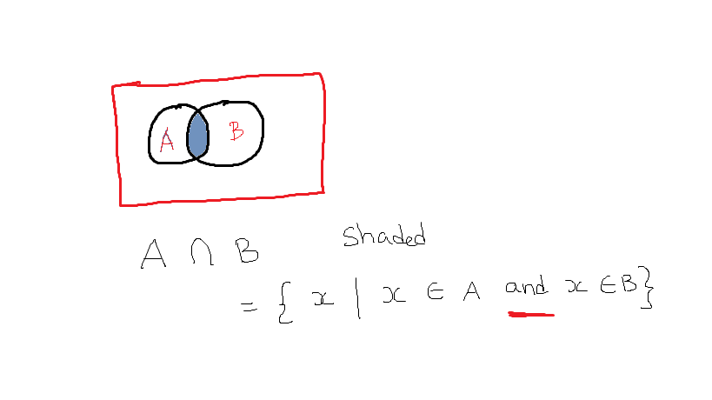
Operation on Set: Intersection

Slide 34
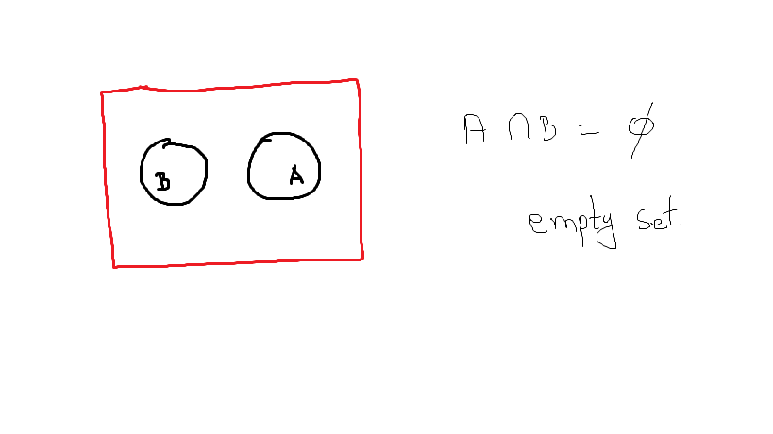
Empty set

Slide 35
Finite and Infinite Sets
X is a set. If there exists a nonnegative integer n such that X has n elements, then X is called a finite set with n elements.
If a set is not finite, then it is an infinite set.
Examples:
Y = {1,2,3} is a finite set
P = {red, blue, yellow} is a finite set
E , the set of all even integers, is an infinite set
∅ , the Empty Set, is a finite set with 0 elements

Slide 36
Cardinality of Sets
Let S be a finite set with n distinct elements, where n ≥ 0. Then |S| = n , where the cardinality (number of elements) of S is n
Example:
If P = {red, blue, yellow}, then |P| = 3
Singleton
A set with only one element is a singleton
Example:
H = { 4 }, |H| = 1, H is a singleton

Slide 37
Power Set
For any set X ,the power set of X ,written P(X),is the set of all subsets of X
Example:
If X = {red, blue, yellow},
then P(X) =
{ ∅ , {red}, {blue}, {yellow},
{ red, blue}, {red, yellow}, {blue, yellow},
{red, blue, yellow} }

Slide 38
Ordered Pair
X and Y are sets. If x ∈ X and y ∈ Y, then an ordered pair is written ( x,y)
Order of elements is important. (x,y) is not necessarily equal to ( y, x )

Slide 39
Cartesian Product
The Cartesian product of two sets X and Y ,written X × Y ,is the set
X × Y ={(x,y)|x ∈ X , y ∈ Y}
For any set X, X × ∅ = ∅ = ∅ × X
Example:
X = {a,b}, Y = {c,d}
X × Y = {(a,c), (a,d), (b,c), (b,d)}
Y × X = {(c,a), (d,a), (c,b), (d,b)}
As you can see, X x Y is not same as Y x X

Slide 41
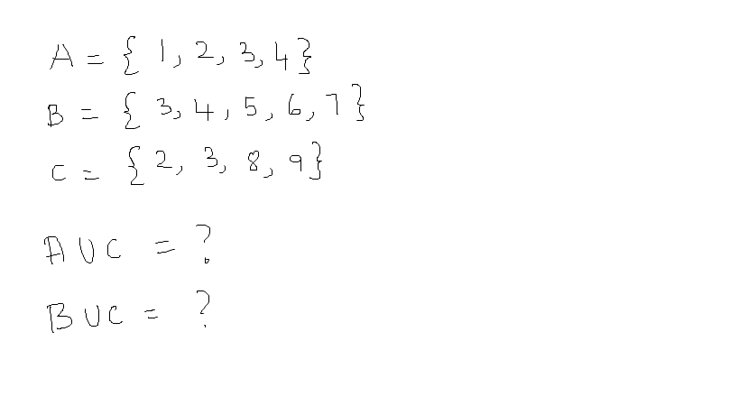

Slide 42
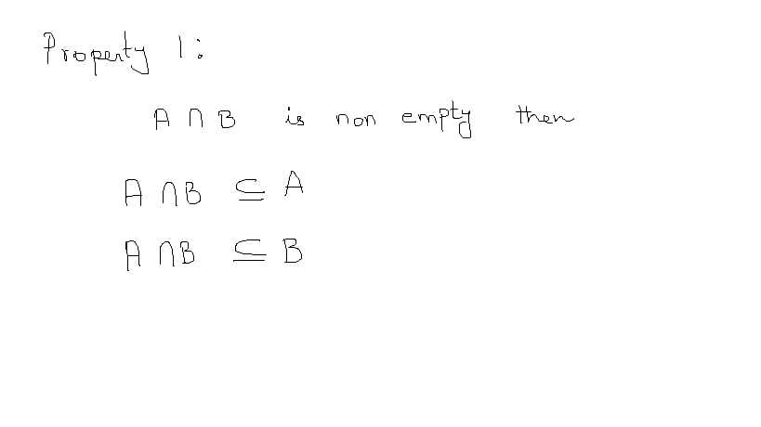

Slide 43
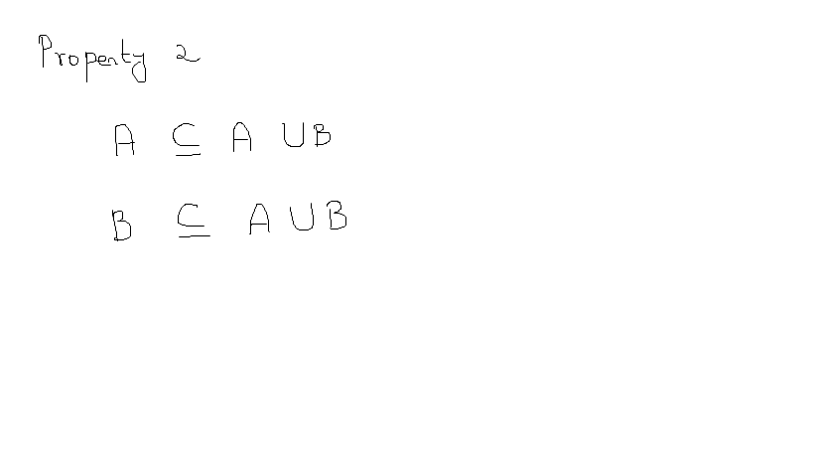

Slide 44
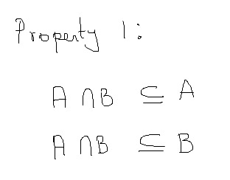
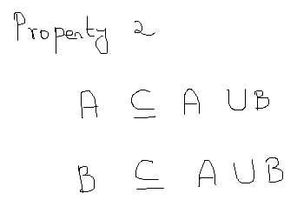
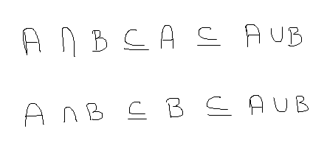
putting property 1 and 2, we have

Slide 45
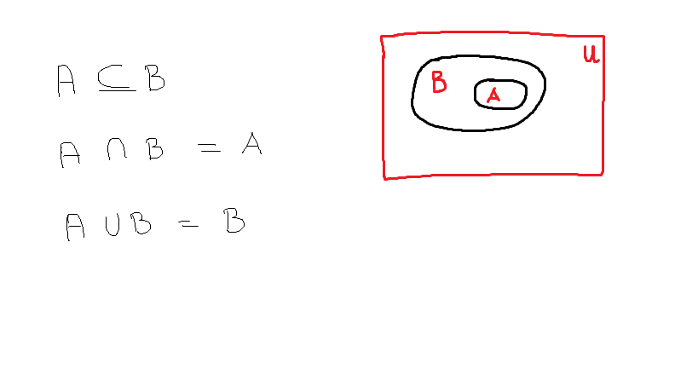

Slide 46
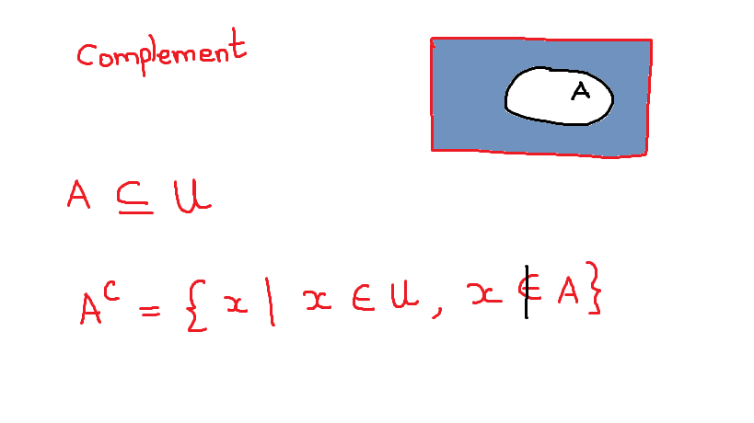

Slide 47
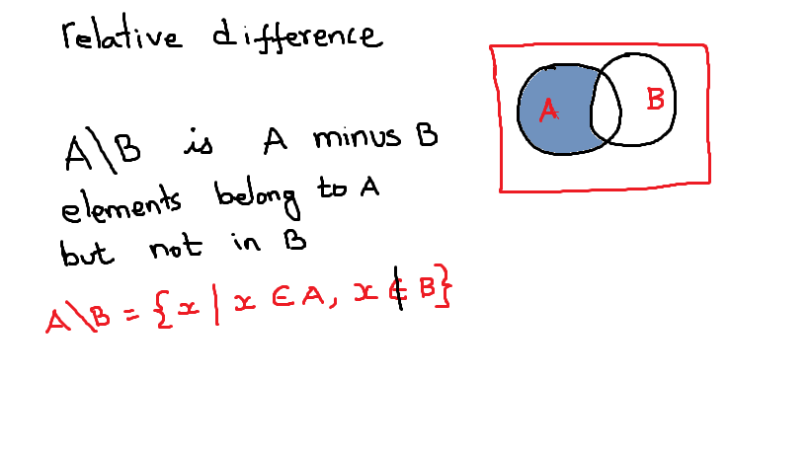

Slide 48
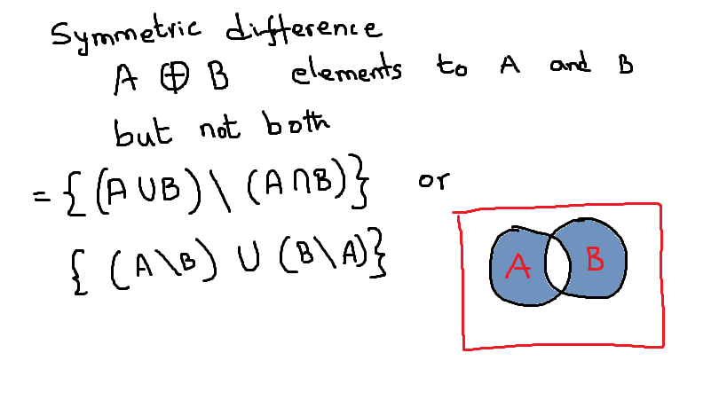

Slide 49
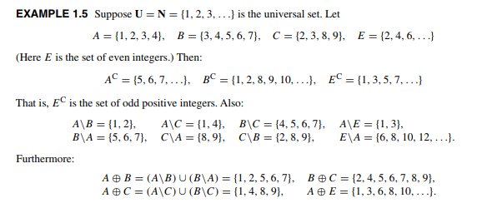

Slide 50
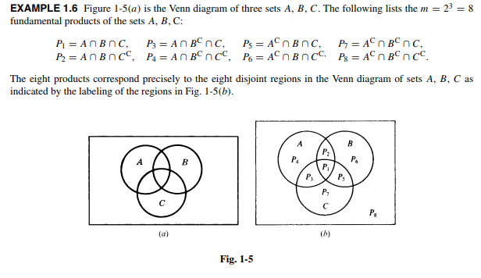

Slide 51
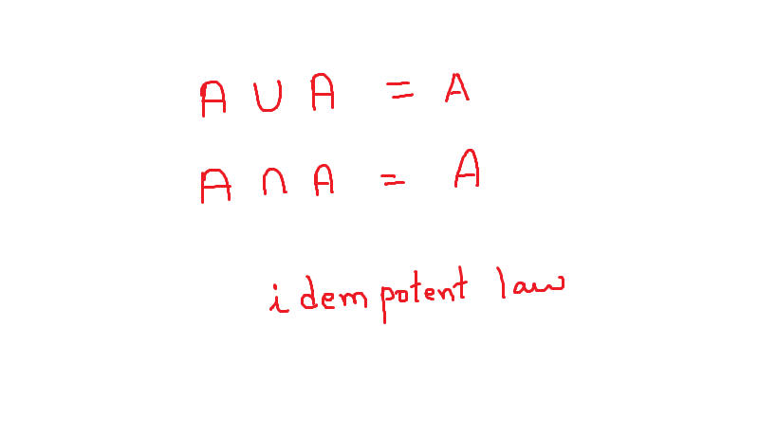

Slide 52
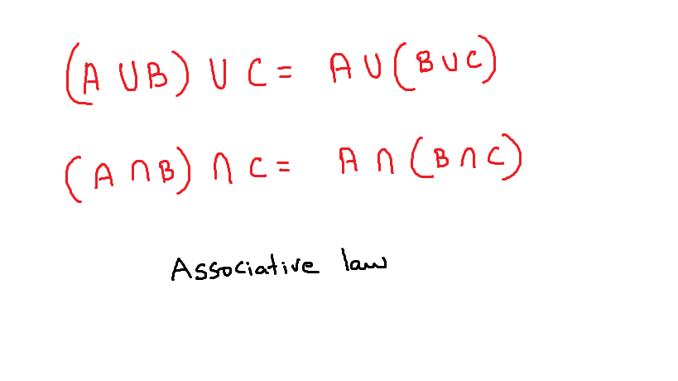

Slide 53
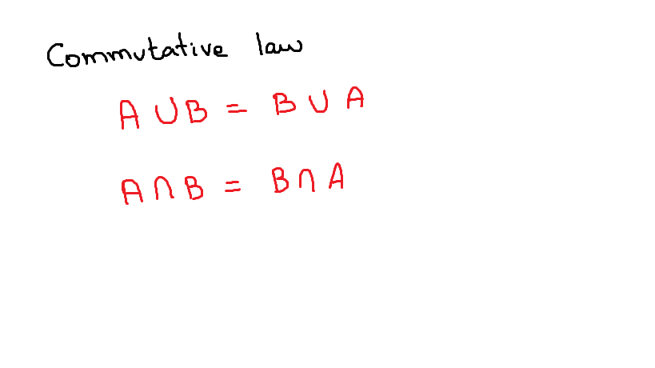

Slide 54
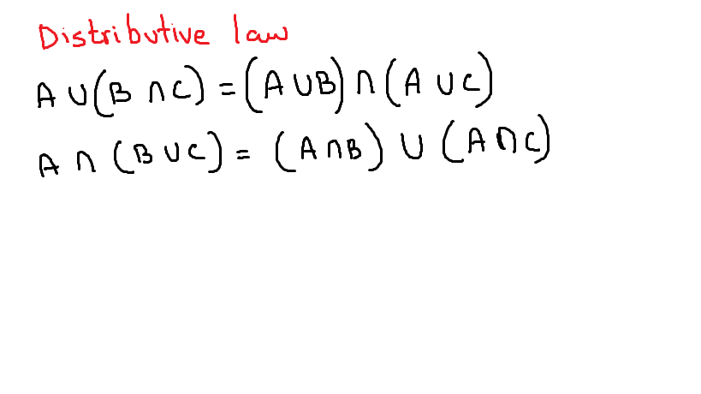

Slide 55
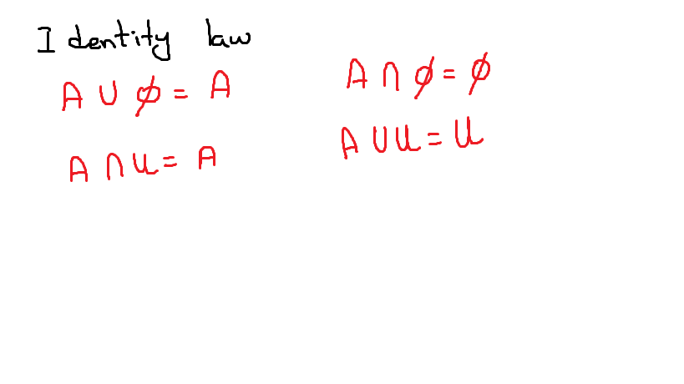

Slide 56
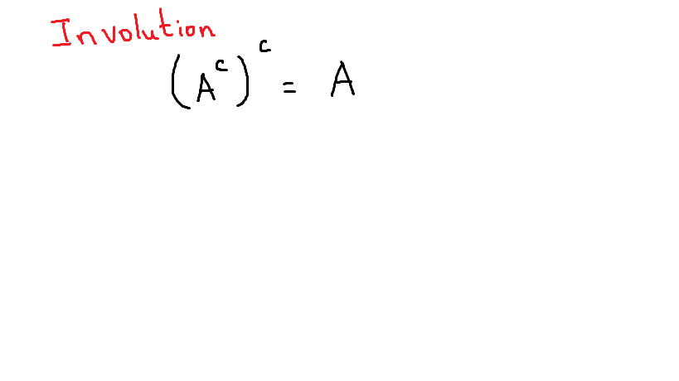

Slide 57
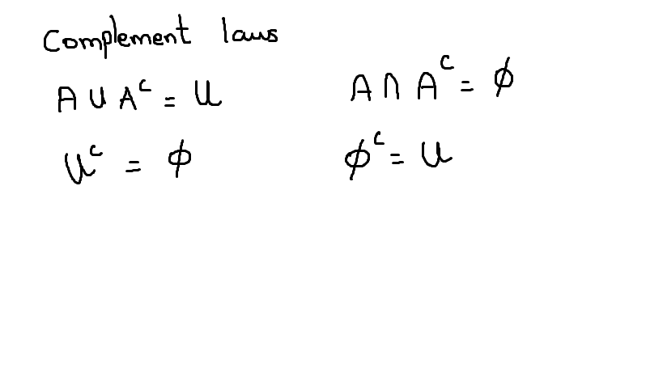

Slide 58
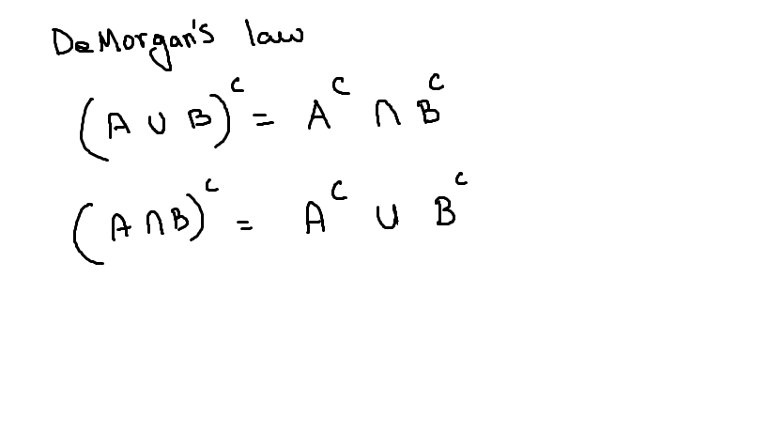

Slide 59
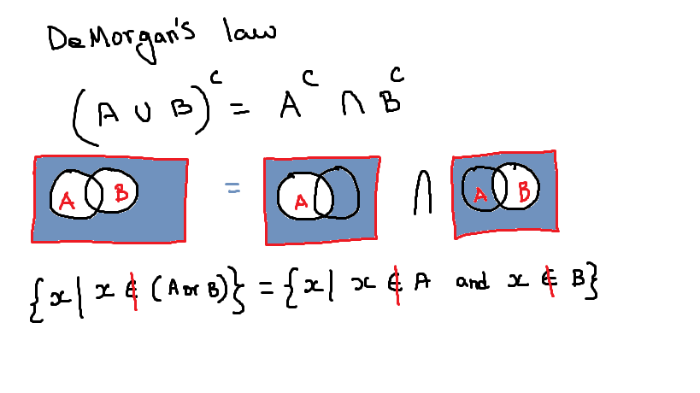

Slide 60


